Slide 1
SOLID PROPULSION TEAM REPORT WEEK 5
NAKUJA PROJECT

Slide 2
WEEK 5 OBJECTIVE
Machining of nozzles
Machining of bulk head
Purchase of 800kgf loadcell
Cooking grains
Design of casting tool
Static test

Slide 3
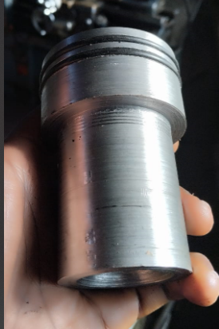
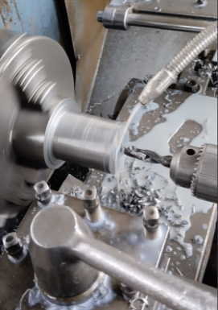
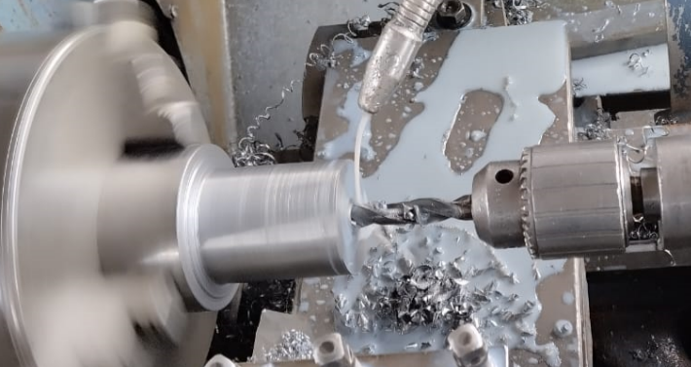
#79 Machining nozzle

Slide 4
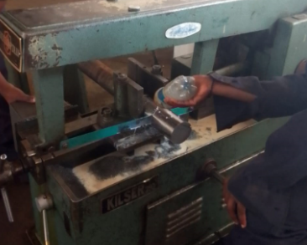
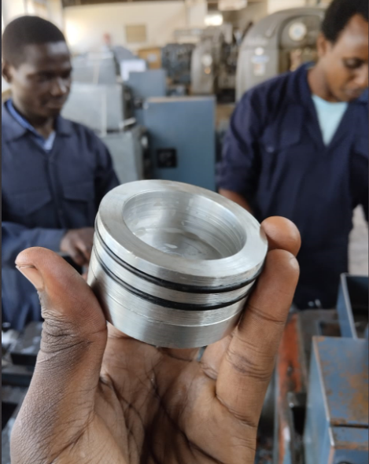
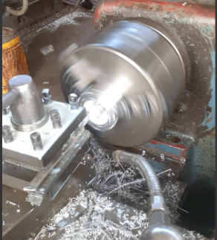
#80 MACHINING OF BULKHEAD

Slide 5
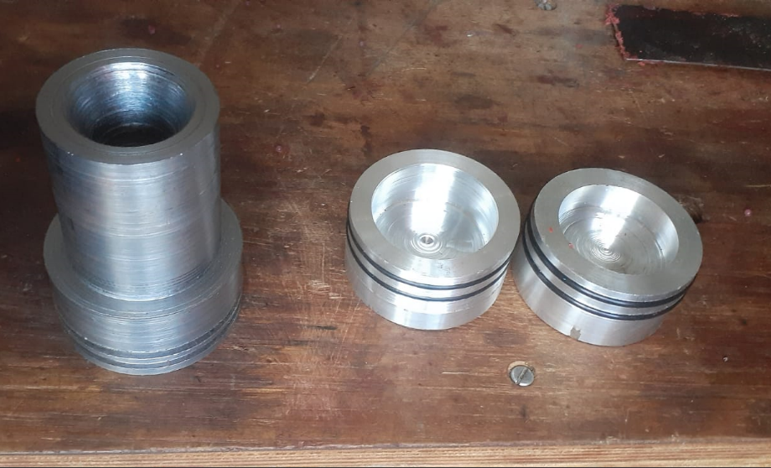
CONTINUED

Slide 6
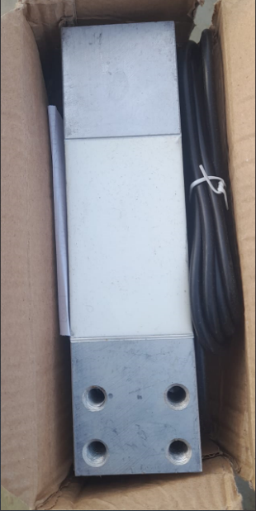
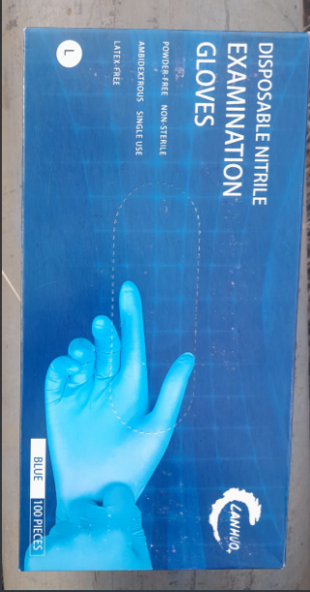
#81 PURCHASE OF LOADCELL AND GLOVES

Slide 7
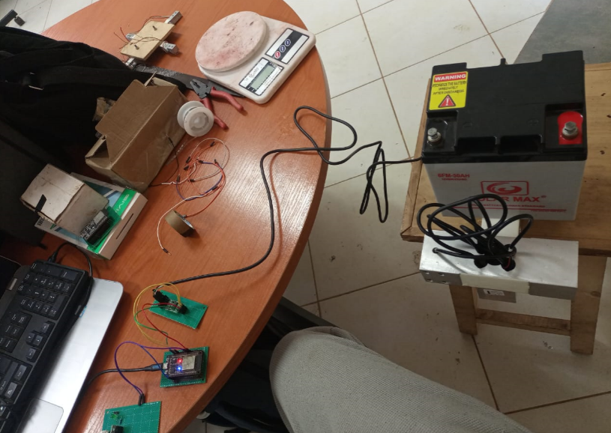
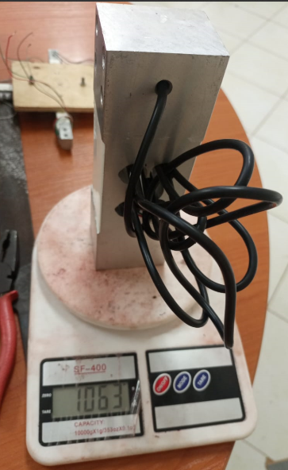
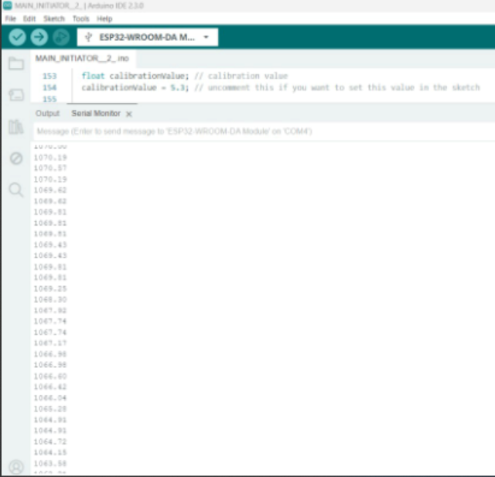
#82 LOADCELL CALIBRATION

Slide 8
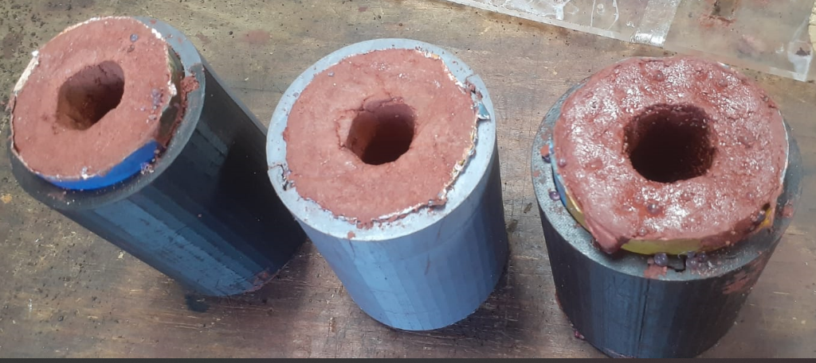
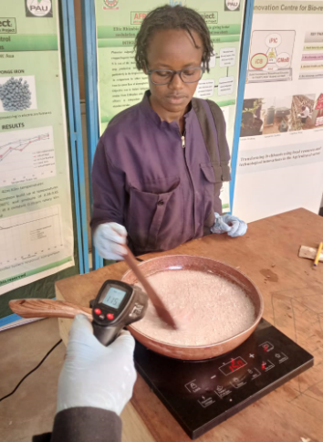
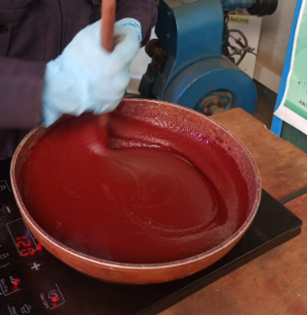
#83 COOKING GRAINS

Slide 9
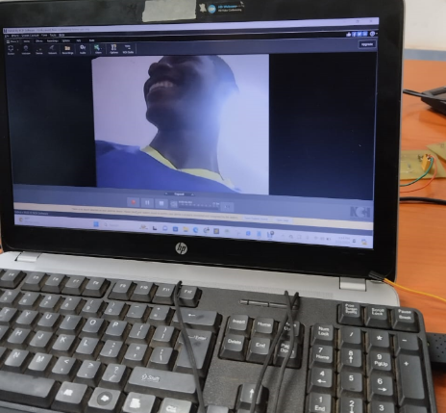
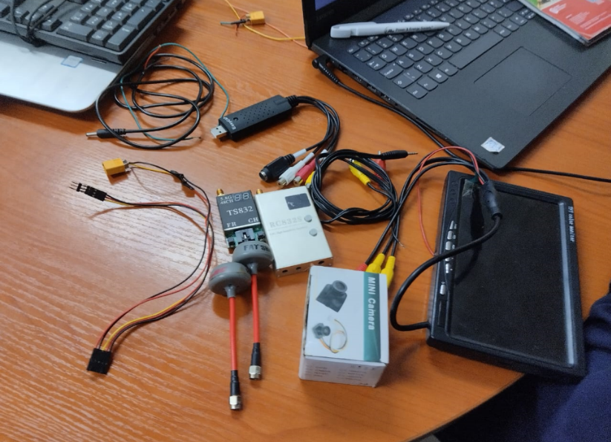
#90 CAMERA MOUNT DISCUSSION

Slide 10
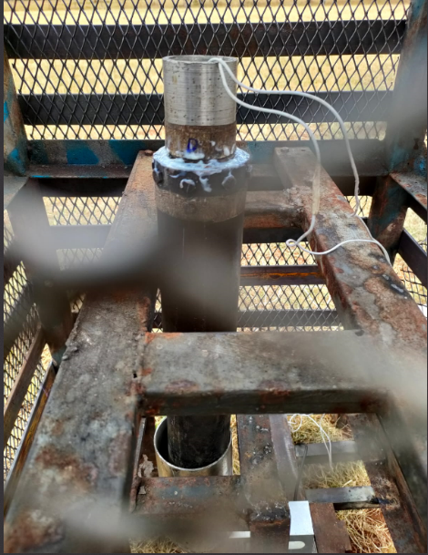
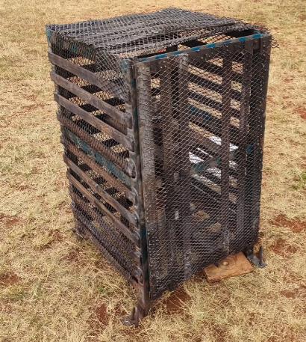
#89 Static Test

Slide 11
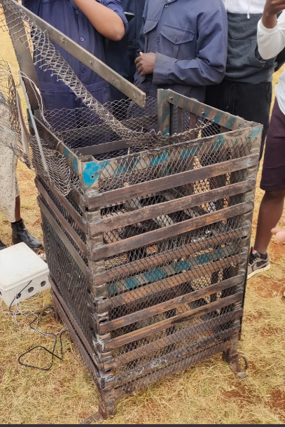
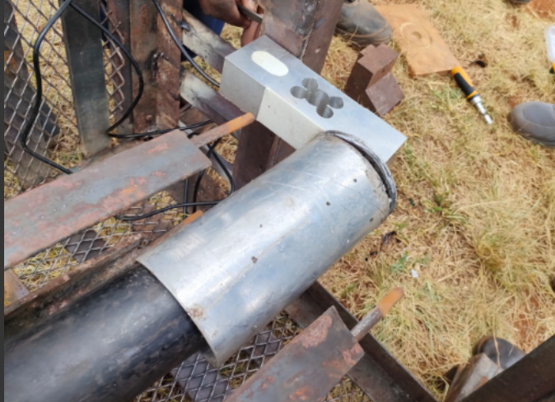
Continued

Slide 12
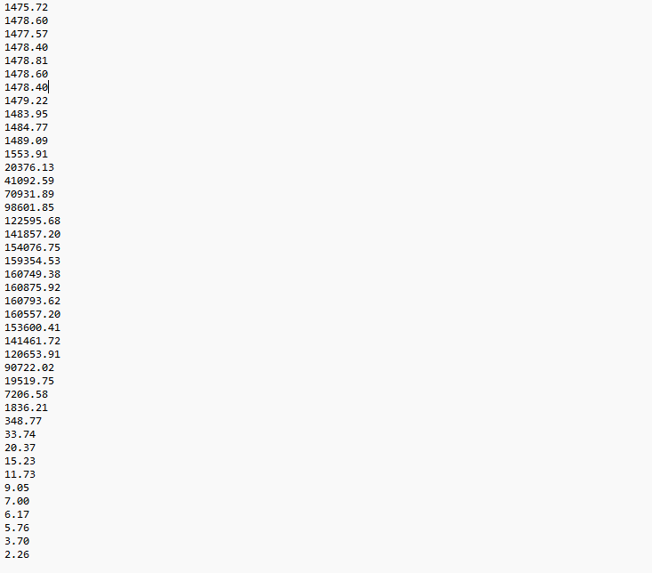
Continued

Slide 13
CHALLENGES
Boring tool – too wide to machine 12mm
- Lack HSS tip.

Slide 14
NEXT WEEK’S OBJECTIVES
Mass fabrication of:
Nozzles
Bulkhead
Purchase of items
Analysis of the static test
Repair of the motor holder and test stand
Design of casting tool

Slide 15
THANK YOU

